Slide 1
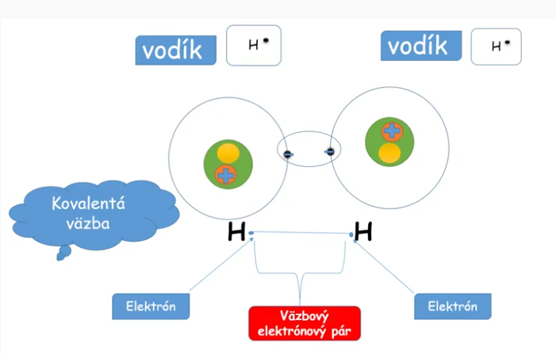
https://www.youtube.com/watch?v=WyIHqDp8sBc

Slide 2
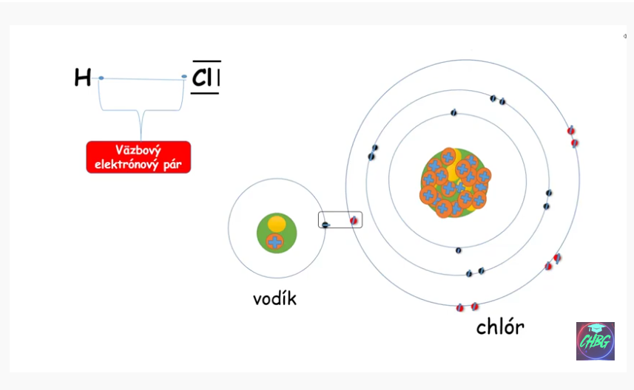

Slide 3
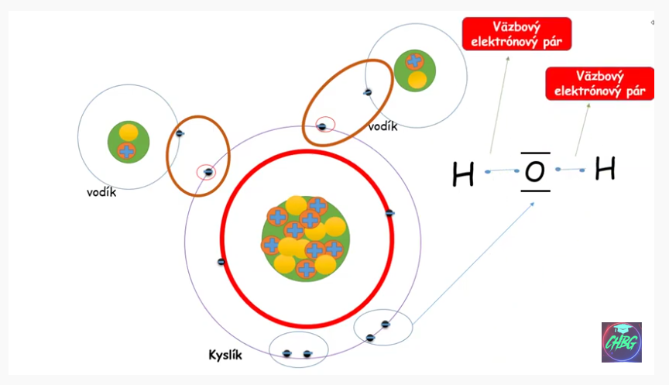

Slide 4
